Slide 1

Master Thesis
Word Sense Disambiguation on Prague Dependency Treebank
Srđan Prodanović

Slide 2
Word sense disambiguation (WSD)
Word senses: can be variable depending on the context
Polysemous words
  “bank” homonyms: financial institution vs. river bank
  “bank” as a financial institution: the company or institution, the building itself, the counter where money is exchanged, a fund or reserve of money, a money box (piggy bank), etc.
Notes:
- I am gonna talk first a bit about the task
-

Slide 3
Applications of WSD
Machine Translation: WSD is needed for a lexical choice of words that have different translations for different senses and that are potentially ambiguous within a given domain
change → changement ('transformation') or monnaie ('pocket money')
Information retrieval: Words in queries need to be disambiguated in order for the IR system to retrieve the correct documents.
depression → illness, weather systems or economics?
Information extraction and text mining: the difference between medical drugs and illegal drugs
Notes:
why is it important?
WSD's importance lies in the fact that it enables other tasks and applications of
computational linguistics and natural language processing (NLP)

Slide 4
Classification of approaches to WSD
Supervised vs. Unsupervised approaches: labeled vs. unlabeled training set of any kind
Corpus based vs. Knowledge informed methods:
  rely primarily on dictionaries, thesauri, and lexical knowledge bases

Slide 5
Unsupervised approaches to WSD
Work directly from raw unannotated corpora
Potential to overcome the new knowledge acquisition bottleneck (manual sense tagging)
Induce word senses from training text by clustering word occurrences, and then classifying new occurrences into the induced clusters/senses
Main approaches:
    Context clustering: cluster word context vectors into context-groups and discriminate based on EM (Schütze 1998)
    Word clustering: cluster semantically similar words into groups and discriminate based on the distance from the centroid (Lin 1998)

Slide 6
Supervised approaches to WSD
Predominantly machine learning techniques that learn a classifier from a labeled training sets of any kind
Some approaches:
  Methods Based on the Similarity of the Example: compare new examples to a set of learned vectors (one for each word sense) and assign the sense of the most similar vector, i.e. Vector Space Models
  Linear Classifiers and Kernel-Based Approaches: hyperplane in an n-dimensional feature space that can be represented with a weight vector and a bias indicating the distance of the hyperplane to the origin i.e. Support Vector Machines that separates the positive examples from the negatives with maximum margin between.

Slide 7
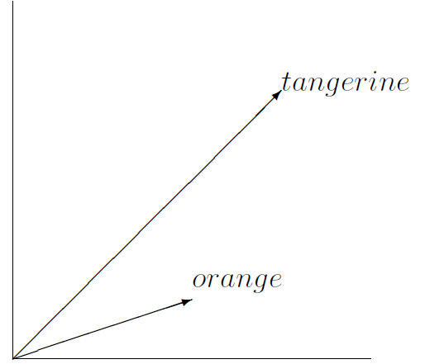
Computational model of semantics
Word Space Models or Vector Space Models (VSM):
“Vector similarity is the only information present in Word Space: semantically related words are close, unrelated words are distant.”
Hinrich Schütze (1993)
Similarity is proximity:
VSM is a spatial
representation of a word's
meaning

Slide 8
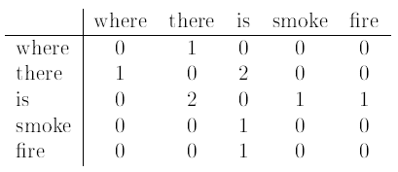
Context vectors
Vectors representing words in VSM, built from word distribution frequencies
Every vector is defined by N components, where each component represents a location in N-dimensional space.
Example: "Where there is smoke there is fire."
Context vector for “smoke”: (0,0,1,0,0)

Slide 9
The co-occurrence matrix
Matrix of co-occurrence counts of words
Term-Document: rows are terms (usually words), columns are documents (i.e. web pages)
Word-Context: context is given by words, phrases, sentences, paragraphs, chapters or documents:
  windows of words (Lund & Burgess, 1996), grammatical dependencies (Lin, 1998) , etc.
Pair-Pattern: reflects the similarity of relations
  Row vectors correspond to pairs of words, carpenter : wood, and column vectors correspond to the patterns in which the pairs co-occur, such as "X cuts Y" and "X works with Y".
Notes:
First 2 reflect attributional, and pair-pattern relational relationship between words
Only first 2 are used in my experiments

Slide 10
High dimensionality and data sparseness
VSM rely on statistical evidence → large data set is needed
With large volume of data → co-ocurrence matrix becomes large (N grows)
With large N → most context vectors are sparse
  Stems directly from Zipf's law (Zipf, 1949) - vast majority of words only occur in a very limited number of contexts
Dimensionality reduction: represents high dimensional data in a low dimensional space, so that both the dimensionality and sparseness of the data are reduced, while still retaining as much of the original information as possible.

Slide 11
VSM that perform dimensionality reduction
Latent Semantic Analysis (LSA, Landauer & Dumais, 1997):
  The dimensionality reduction is accomplished by using a statistical dimensionality reduction technique called Singular Value Decomposition
Hyperspace Analogue to Language (HAL, Lund et al., 1995):
  words-by-words co-occurrence matrix co-occurrences within a weighted directional context window 10 words wide

Slide 12
VSM that perform dimensionality reduction
Random Indexing (RI, Kanerva et al., 2000; Karlgren & Sahlgren, 2001)
Incrementally accumulates context vectors:
  each document or each word type in the text is assigned a unique and randomly generated representation called an index vector
  Word context vectors are accumulated from index vectors of contexts it is found in
Word's context vectors are effectively the sum of the word's contexts.

Slide 13
Advantages of RI
Initially fixed dimensionality (r<<N)
The r-dimensional random index vectors are only nearly orthogonal – approximation of orthogonality of sparse context vectors with dimensionality N
Robust in regard to the choice of orthogonality- LSA and HAL matrices need to be recomputed every time when a new context vector is inserted

Slide 14
Experiments
Preprocessing
Three Vector Space Models (TFIDF, PMI, RI)
Classification and Tuning
Evaluation

Slide 15
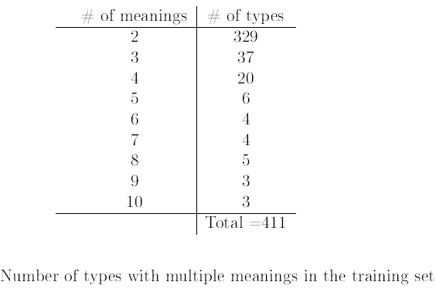
The resource
Prague Dependency Treebank (PDT), which is among other things a corpus annotated for word senses

Slide 16
Preprocessing
Text normalization- normalize Czech spelling variants: abcházská and abchazská
Stemming (optional): reducing inflected (or sometimes derived) words to their stem, base or root form
Word Filtering: POS (closed grammatical classes)
Idea → reduce noise and dimensionality, without loosing information

Slide 17
Vector Space Models
Document size in the co-ocurrence matrix: a tuning parameter for all 3 models
  {1,3,5} sentence paragraph
  {1,2,3} neighboring words of preceding and succeeding context around the polysemous word

Slide 18


Normalization of frequency counts (1)
TF-IDF(Robertson & Spärck Jones, 1997):
TFij is the frequency of term i in document j, DFi is some function of the number of documents term i occurs in (DF for document frequency ), and Sj is a normalizing factor, usually dependent on the length of document(s for scaling)
D is the total number of documents in the whole corpus.

Slide 19

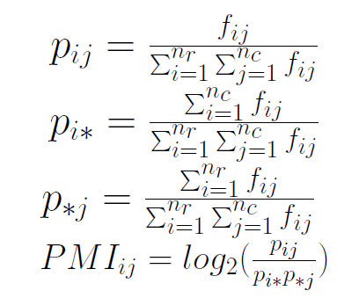
Normalization of frequency counts (2)
PMI(Church & Hanks, 1989)
The ratio between p(word1&word2) and p(word1)p(word2) product is a measure of the degree of statistical dependence between these words.
pij is the estimated probability that the word wi occurs in the context cj ,
pi* is the estimated probability of the word wi,
p*j is the estimated probability of the context cj .

Slide 20
Dimensionality reduction
Random Indexing
  Frequency counts of elements were not normalized

Slide 21

Evaluation context size
The number of words taken from preceding and succeeding context of the occurrence of ambiguous word
Similarity measure: cosine
Example:
“Krumbachová práci prijmout-2 podle-2 vlastní-1 slov " v-1 hodinê dvanácté ".
(Krumbach has accepted the job " in the last minute" .)
1. prijmout-2: práci podle-2
2. podle-2: prijmout-2 vlastní-1
etc.

Slide 22
Evaluation metrics
Sentences extracted from PDT are divided into three sets: training(9/10), test development (1/20) and test final(1/20)
Training phase: trained on training set, tuned on test development
Evaluation phase: trained on merge of training and test development, tested on test final set
TP++ : If the model calculates the correct “meaning"
FP++ : if it does not
FP++, FN++ : If the meaning encountered during testing is not encountered during training

Slide 23
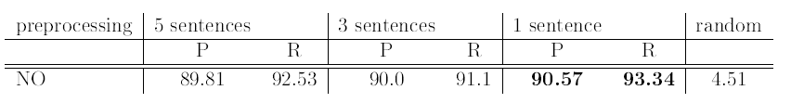
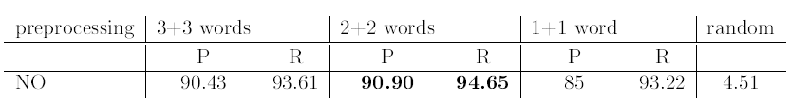
Results: TF-IDF
Tuning preprocessing parameters, with evaluation context size set to 3, and threshold number of meanings set to 6
Possible values:
  No preprocessing
  Lowercasing, Closed Class, Stemming+Merging of lexical variants, Closed Class+Stemm+Merge

Slide 24
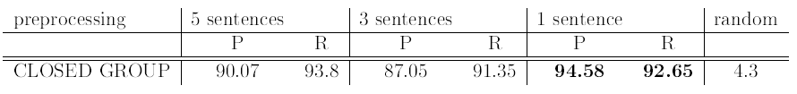
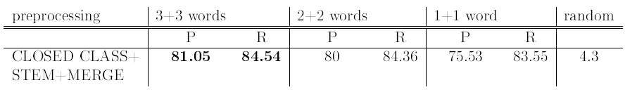
Results: TF-IDF
Best: Closed Group Filtering
Worst:

Slide 25

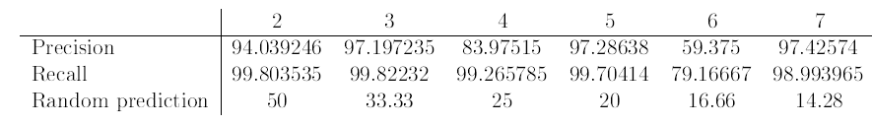
Results: TF-IDF
Tuning evaluation context size {1..7}, with: preprocessing = filtering closed class words, meaning threshold = 5, document size = 1 sentence
Evaluation on polysemous words of different level

Slide 26
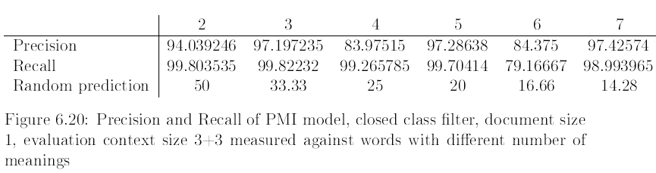
Results: PMI

Slide 27
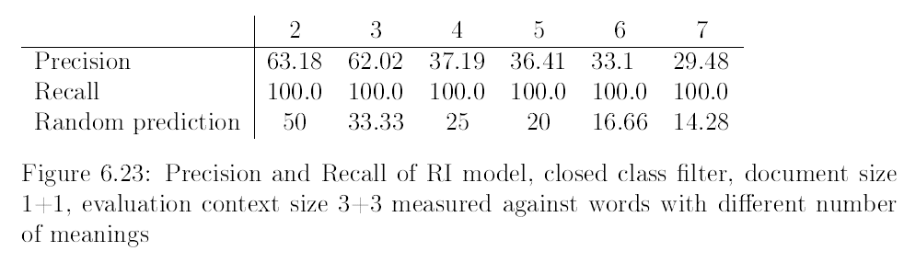
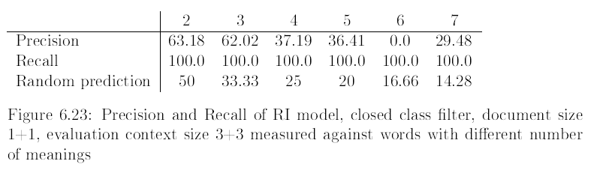
Results: RI

Slide 28
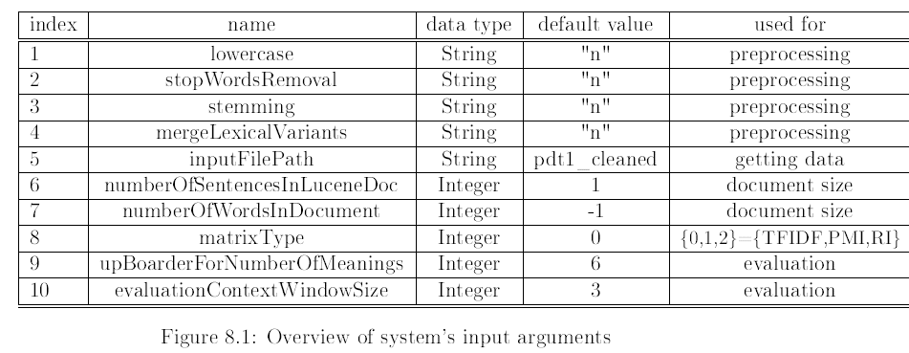
Implementation
Java
Third party: Apache Lucene, Semantic Vectors
Accepts parameters from the command line
[-argumentType argumentValue]*
Logs:

Slide 29
Conclusion
WSD on PDT data set – results comparable to state of the art WSD
Best model: TFD-IDF
Preprocessing: Closed word group filtering
Document size: 3+3 word window or 1 sentence
Future work: testing the program on another data set

Slide 30
Thank you
Questions?

